Slide 1
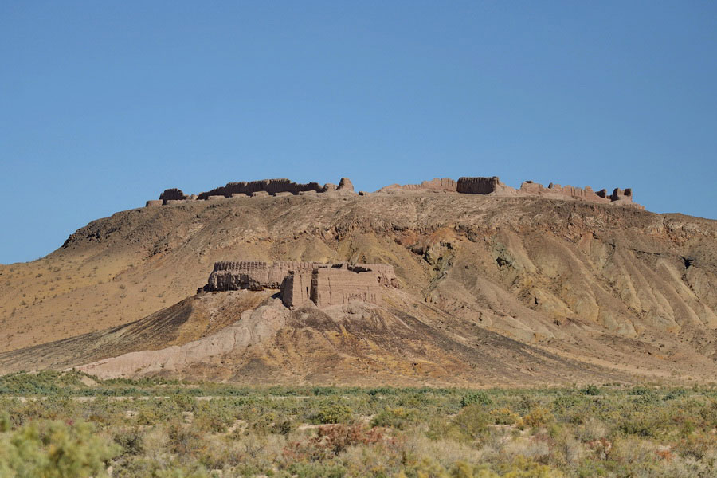


Full itinerary and detailed information about the trip.
In the footsteps of ancient Civilizations
BEST CHOICE
BEST PRICES
RELIABLE TEAM

Slide 2

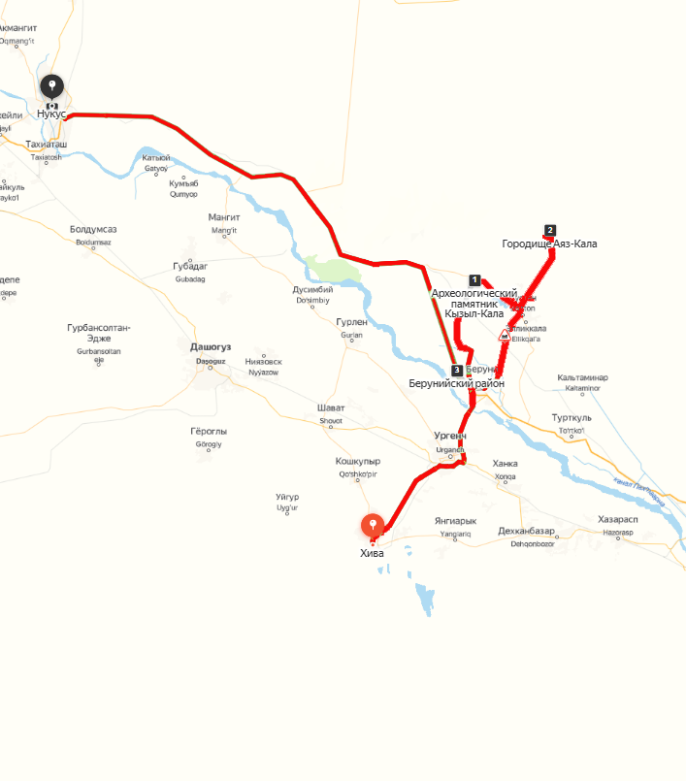

Trip itinerary
Duration:
2 days / 1 night
Tour season:
Year-round
Total distance:
More than 330 km
Meals:
On request
Transport:
Sedan - Minibus

Slide 3

Day 1: Khiva, Kyzyl-kala, Toprak-kala, Bolshoy Guldursun, Ayaz-kala
Start point:
Khiva city
09:00 Our tour starts from the historical city of Khiva.
10:30-11:00 Visit to the Kyzyl Kala fortress (Red Fortress) I-IV-VII centuries AD. This is a defensive fortress, inscribed in the chain of Khorezm fortifications. Here, you can consider the architectural features and feel the greatness of ancient history.
11:15-12:00 Visit to the Toprak-Kala Palace ("Clay Fortress") of the I-IV century AD, which was the residence of the kings of ancient Khorezm in the ancient period. The preserved walls of Toprak Kala allow you to feel the most important events of centuries-old history.
12:30-13:30 Lunch at Lake Akchakul, where you will taste the taste of Karakalpak dishes.
14:30-15:00 Next visit to the fortress of Jambas Kala (IV- century BC and I century AD), which belongs to the Kangyu period. The walls of the fortress speak of the greatness and power of an ancient civilization.
16:00 Arrival at Ayazkala yurt camp. Here you have a chance to live one day as a nomad and experience the freedom of nomadic life.
19:00 Dinner in the style of national flavor. After dinner, you can plunge into the romance of watching the big stars in the sky.
Day 2: Zhampyk-kala – Shylpyk – Nukus
07:00 Breakfast, filling you with energy for new discoveries.
08:30 Visit to the Badai Tugai National Reserve. In which Bukhara deer, saiga, foxes, etc. listed in the Red Book of Uzbekistan are bred.
10:00-11:30 Visit to the Dzhampyk Kala fortress (IV-I centuries BC, X-XII centuries AD), where you can capture the fortress on camera against the background of a delightful landscape.
12:30-13:00 Transfer to Chylpyk (1st century AD), where you will get acquainted with the history of Zoroastrian culture. The Dahma "Tower of Silence" rises in front of the eye and the landscape opens onto the Amu Darya River. This place immerses everyone in the imagination of rituals and mysticism.
14:00-15:00 Lunch in the city of Nukus.
15:00-18:00 Visit to the I.V.Savitsky Karakalpak State Museum of Art, which has a magnificent collection of the Russian avant-garde of the 1920s and 1930s.
18:30 Accommodation in a cozy hotel. Completion of the program.

Slide 4
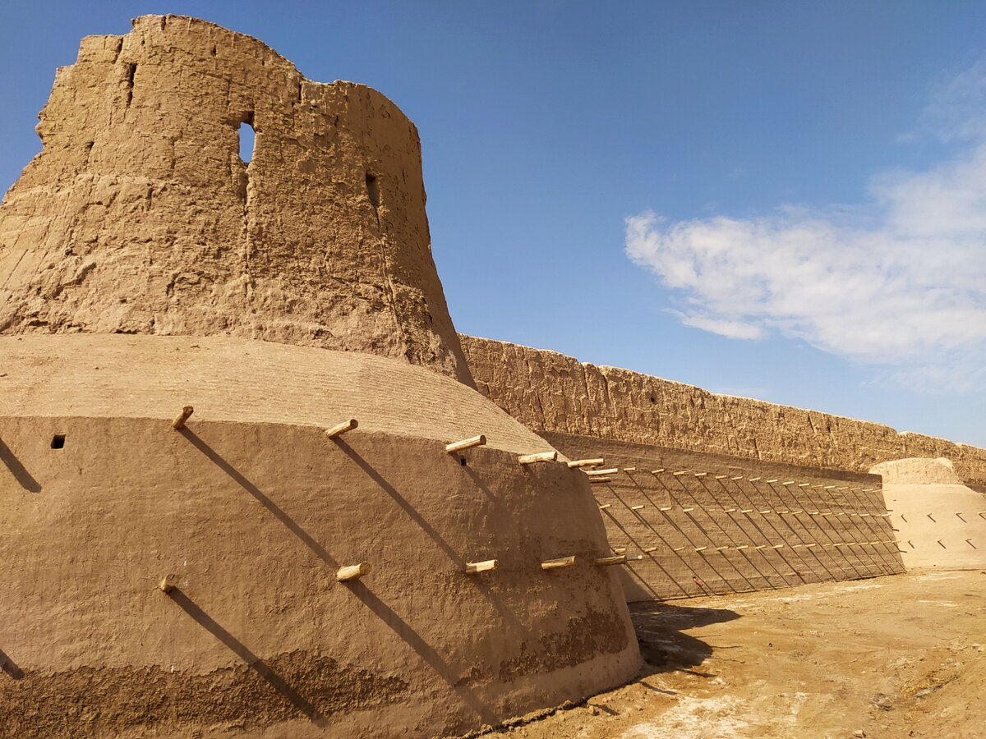
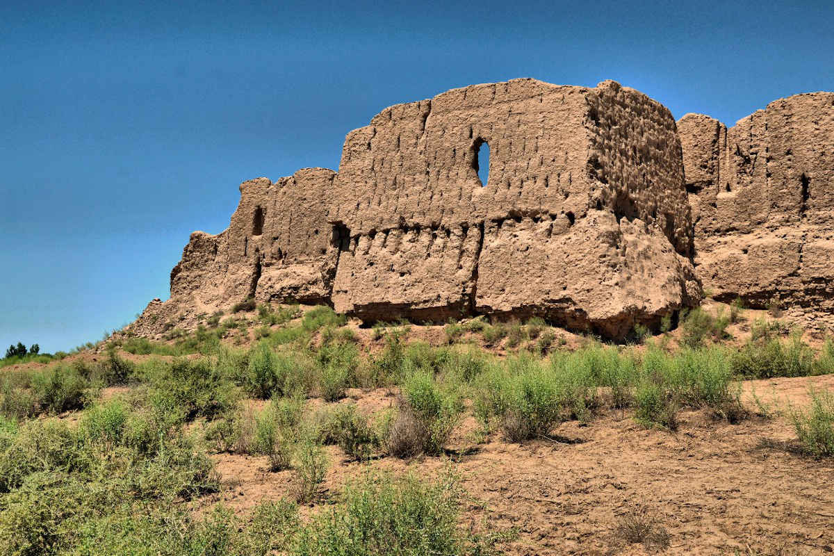
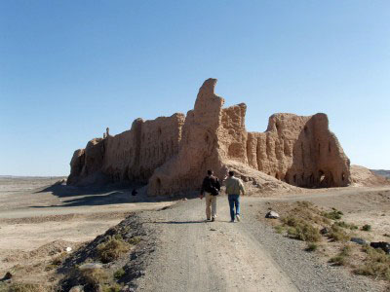
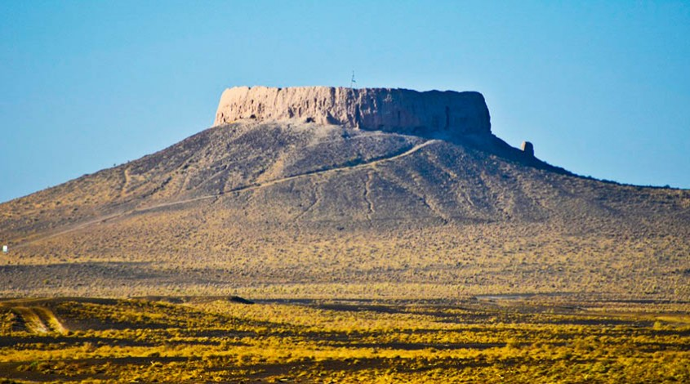
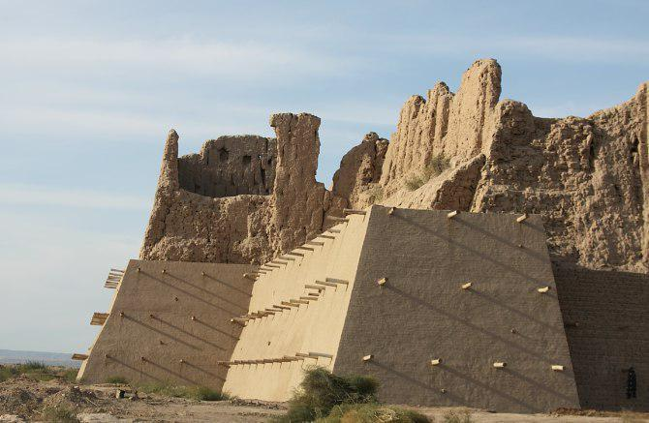
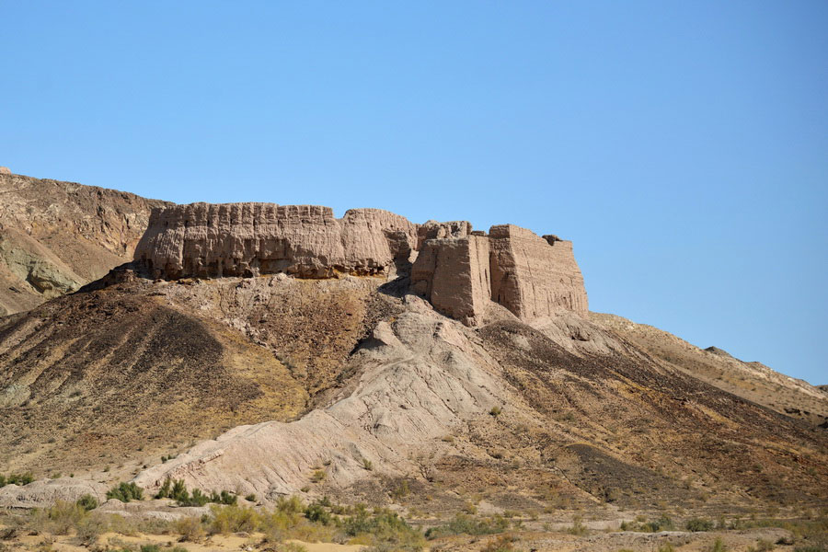
www.besqala.com

Slide 5
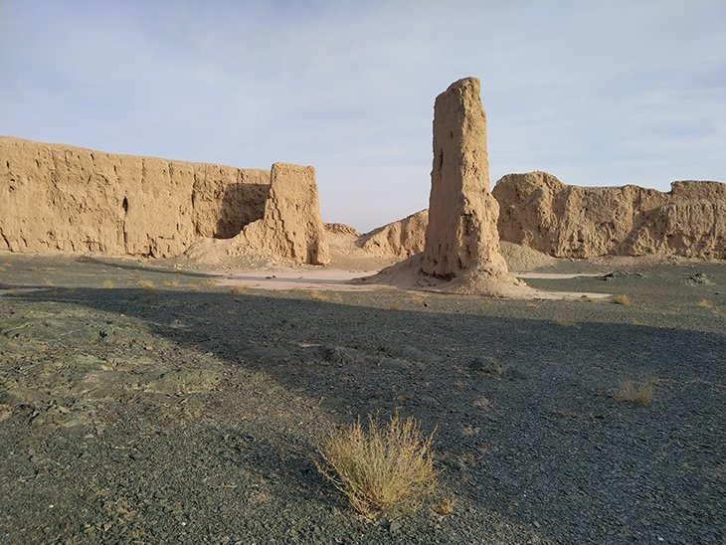
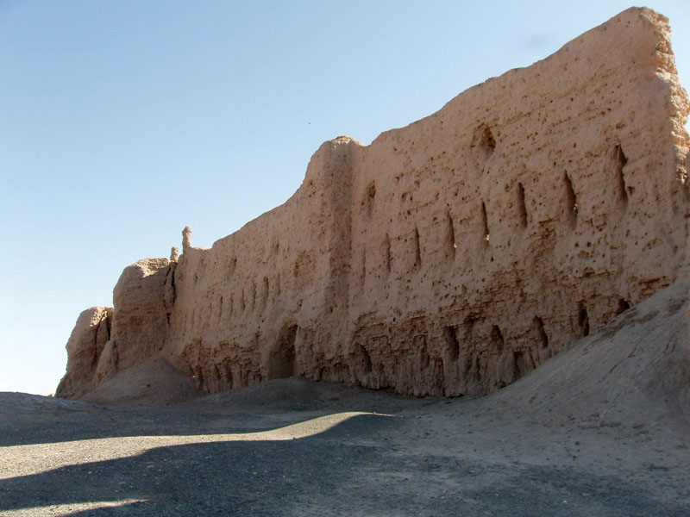
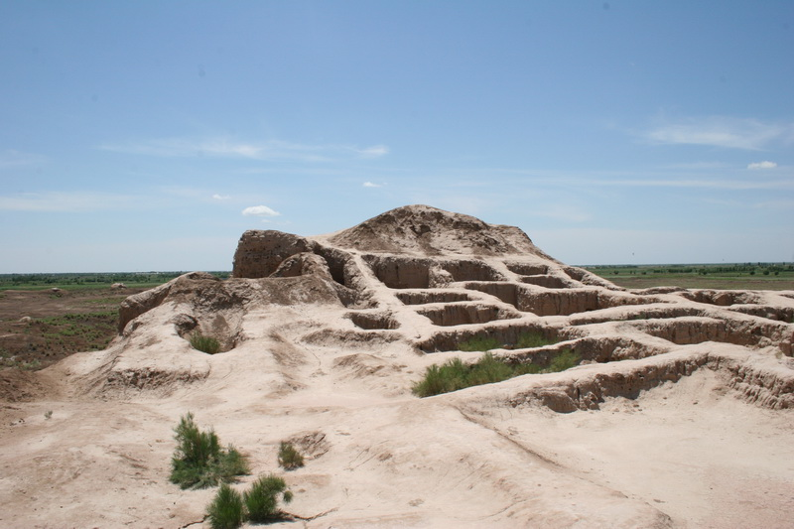
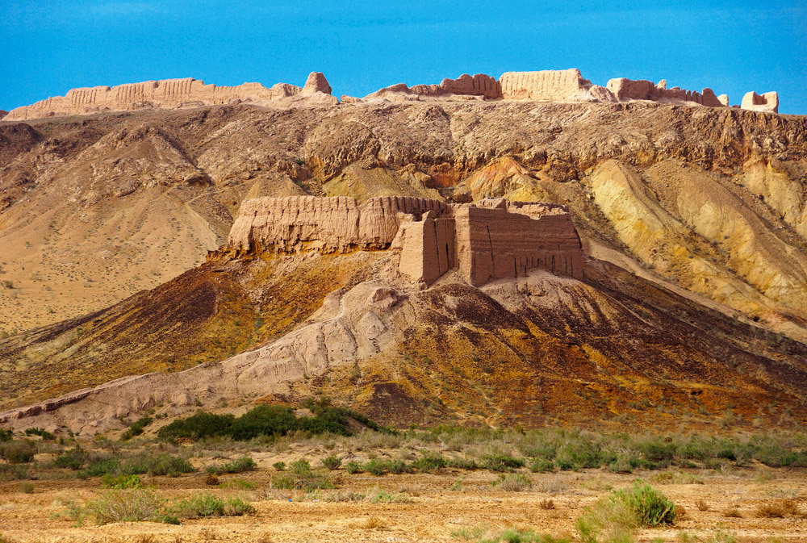
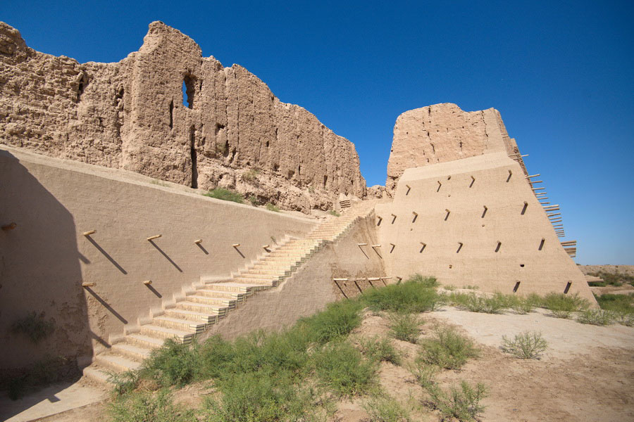
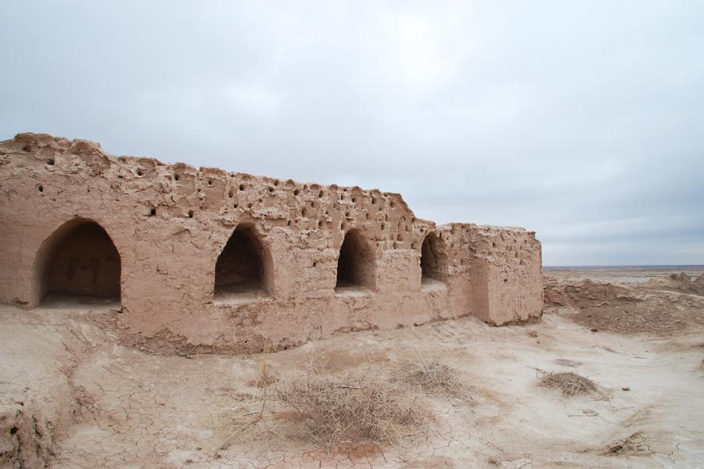
www.besqala.com

